Slide 1
AI Methods for Business
Group 9

Slide 2
Introduction
Multi-Collinearity VIF
Dropping Certain columns
Correlation model
Kruskal-Wallis H tests
Notes:
Year - The year of release is irrelevant because we are considering movie data across different years that all have same chance of a good performance.
International and Domestic Box office - The Worldwide box office is already a sum of the international and domestic box offices. As such, we are only keeping the worldwide box office as the feature to be predicted.
Opening Weekend - Since we are trying to predict the box office sales using features that are before the fact, we consider 'opening weekend' sales as an after the fact and thereby irrelevant to our model.
Avg run per theatre - Since we are trying to predict the box office sales using features that are before the fact, we consider 'Avg run per theatre' sales as an after the fact and thereby irrelevant to our model.
Runtime - Runtime for movies are mostly not a factor considered when consumers decide if they would see a movie as this is usually known when they eventually view the movie. Thus, we believe this is not a feature that contributes to movie sales.
Url - This url link is an online location of the movie thus irrelvant for prediction.
Keywords - This is a search parameter in the data and irrevant feature for prediction.
Summary - This is a descriptive parameter of each movie and irrelevant to our prediction research.
release_Date - This is a duplicate data and thus irrelevant.
awards - Awards indicates an event that indicates post movie release and dependent on movie performance. It cannot be used to predict movie sales, thus irrelevant to our research.

Slide 3
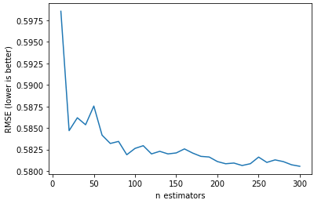
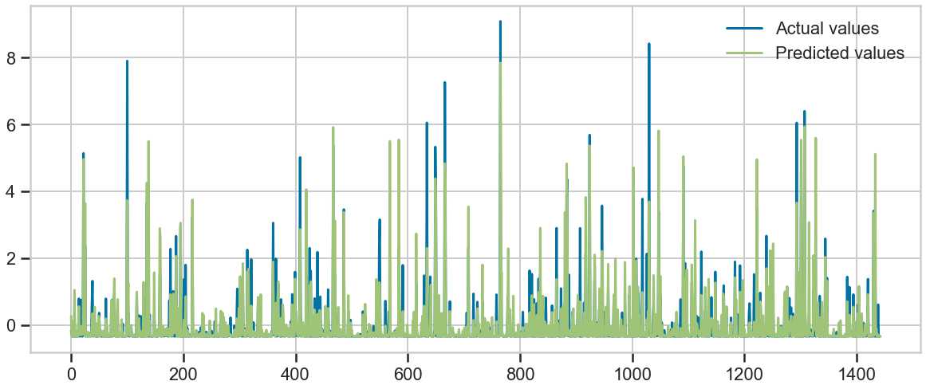
Random Forest
Default hyperparameters to 100 trees
Train 5768 and Validation 1443
Regression Mean of all Trees

Slide 4
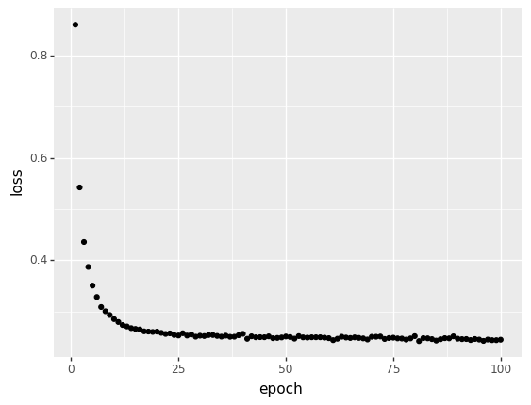
Neural Network
For the Neural Network, We tried to train the data to predict the world-wide box office.
The model ran well on the training data set with a minimum loss cost of ~ 0.3

Slide 5
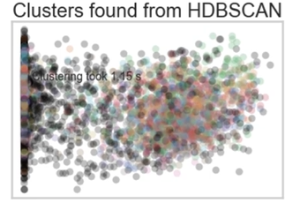
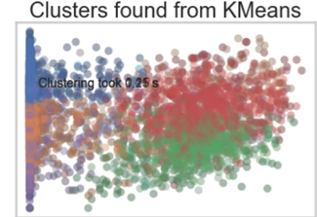
Clustering
PCA & Kmeans
Number of components is 4
The most important features: metascore, theater count and genre
The number of clusters is 5
The cluster model: Most important features with a score of SC 0.8 and DBI 0.5
The K-means model shows some clusters whereas HDBSCAN is not able to differentiate any cluster
Conclusion:
Best cluster model > Most important feature
Highest performing studio > IFC films
Highest performing genre > Drama

Slide 6
Conclusion
Black Box
Random forest gives an higher metric than Neural Network
metascore, theater count and genre
K-Means over DBSCAN
Model | R2 | MSE | RMSE | MAE
Random forest | 0.71 | 0.28 | 0.53 | 0.20
Neural Network | 0.61 | 0.39 | 0.62 | 0.18
KNN model | 0.68 | 0.33 | 0.58 | 0.21

